Slide 1
EN 410 Energy Management
Gurubalan Annadurai
guru.a@iitb.ac.in

Slide 2
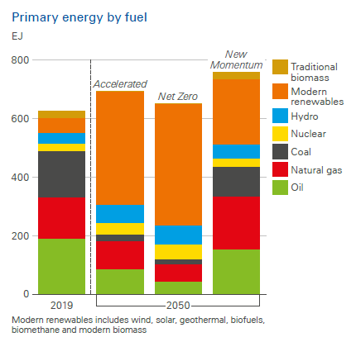
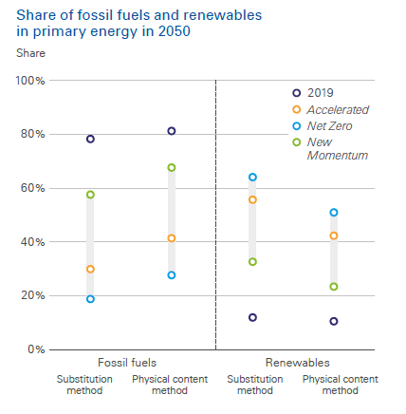
World energy need by fuel type

Slide 3
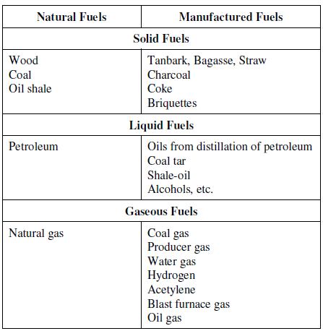
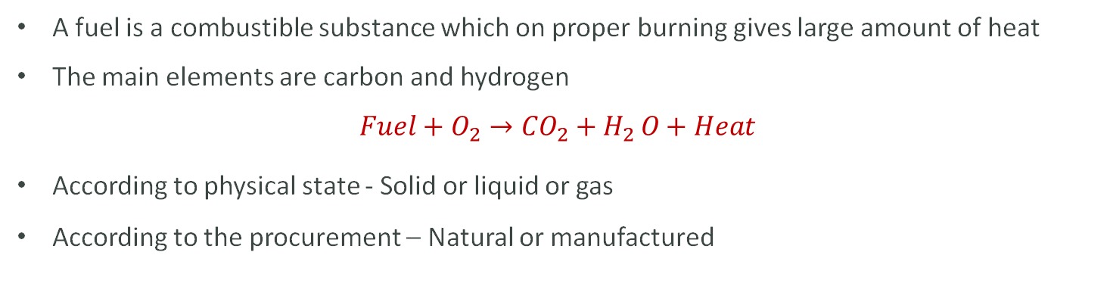
Fuel
A fuel is a combustible substance which on proper burning gives large amount of heat
The main elements are carbon and hydrogen
$$Fuel+O_{2}→{CO}_{2}+H_{2 }O+Heat$$
According to physical state - Solid or liquid or gas
According to the procurement – Natural or manufactured

Slide 4
Properties of fuel
The calorific value of a fuel is the quantity of heat produced by its combustion – at standard conditions for the given quantity
Higher Calorific Value - the water of combustion is entirely condensed and the heat contained in the water vapor is recovered
Lower Calorific Value - the products of combustion contains the water vapor and the heat in the water vapor is not recovered
Ash content – related to inorganic material, excessive may lead to erosive effect on burner tips
Sulphur – depend of source, risk of corrosion by sulphuric acid formation during and after combustion, condensing in cooled parts
Carbon residue - tendency to deposit carbonaceous solid residue on a hot surface
Water Content - present in free or emulsified form

Slide 5
Advantages Disadvantages
They posses higher calorific value per unit mass than solid fuels
They burn without dust, ash, clinkers, etc.
They are easy to transport through pipes
They can be stored indefinitely without any loss
Their firing is easier and also fire can be extinguished easily by stopping liquid fuel supply
They are clean in use and economic to handle
Loss of heat in chimney is very low due to greater cleanliness
They require less excess air for complete combustion
They require less furnace space for combustion
The cost of liquid fuel is relatively much higher as compared to solid fuel
There is a greater risk of fire hazards, particularly, in case of highly inflammable and volatile liquid fuels
Costly special storage tanks are required for storing liquid fuels
For efficient burning of liquid fuels, specially constructed burners and spraying apparatus are required

Slide 6
Solid Fuels
Advantages
They are convenient to store without any risk of spontaneous explosion
Their cost of production is low
They are easy to transport
They posses moderate ignition temperature
Disadvantages
Their ash content is high
Their cost of handling is high
Their large proportion of heat is wasted
They burn with clinker formation
Their combustion operation cannot be controlled easily

Slide 7
Gaseous Fuels
Advantages
They are clean in use
They burn without any shoot, or smoke and ashes
They are free from impurities found in solid and liquid fuels
They do not require any special burner
They can be conveyed easily through pipelines to the actual place of need, thereby eliminating manual labour in transportation.
They can be lighted at ease.
They have high heat contents and hence help us in having highertemperatures.
They can be pre-heated by the heat of hot waste gases, thereby affecting economy in heat.
Their combustion can readily by controlled for change in demand like oxidizing or reducing atmosphere, length flame, temperature, etc.
Disadvantages
Very large storage tanks are needed.
They are highly inflammable, so chances of fire hazards in their use is high.

Slide 8
Combustion
A chemical reaction during which a fuel is oxidised which is accompanied with a large quantity of heat
Oxidizer – pure oxygen Air – free and readily available
C + O₂ → CO₂ + 8084 kcal/kg of carbon burnt
H₂ +1/2 O₂ → H₂O + 28922 kcal/kg of H₂
S + O₂ → SO₂ + 2224 kcal/kg of S
C+1/2 O₂ → CO + 2430 kcal/kg of carbon burnt
Each kg of CO formed means a loss of 5654 kcal of heat

Slide 9
Combustion
Air: 20.9% oxygen, 79% nitrogen and other (vol. basis)
Effect of Nitrogen
Nitrogen acts as inert gas, no reaction except forming of small amount forms NOx at high temperatures
Nitrogen reduces the combustion efficiency by absorbing the combustion heat
Effect of water vapor
Only water vapour needs consideration in other gases
Moisture H₂O which is inert during combustion and reduces the combustion efficiency
Rarely, H₂O H₂, O₂ , H, O, OH
When cooled below dew point temperature, condensate water reacts with SO₂ to form sulphuric acid which is corrosive

Slide 10
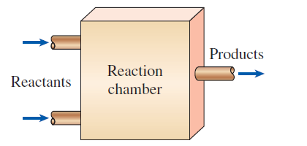
3 Ts to optimize combustion
Temperature high enough to ignite and maintain the ignition of fuel
Turbulence mixing of fuel and oxygen
Time sufficient for complete combustion

Slide 11
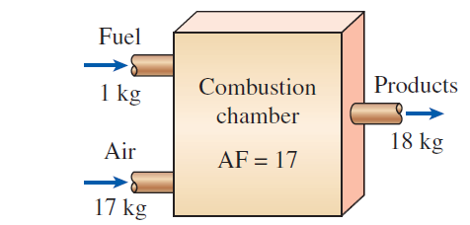
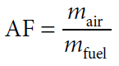
Air-Fuel
Air-fuel ratio (AF): The ratio of the mass of air to the mass of fuel for a combustion process
Stoichiometric or theoretical air: The minimum amount of air needed for the complete combustion of a fuel. Also referred to as the chemically correct amount of air, or 100% theoretical air.
Stoichiometric or theoretical combustion: The ideal combustion process during which a fuel is burned completely with theoretical air.

Slide 12
Excess Air
Certain amount of excess air is needed to complete combustion and ensure that release of the entire heat contained in fuel
Less air would lead to the incomplete combustion and smoke
More excess air: additional heat would be lost in heating the surplus air to the chimney temperature → increased stack loss
Optimally controlled by monitoring the flue gases – 14-15% of CO₂ and 2-3% for O₂

Slide 13
Theoretical and Actual Combustion Processes
Complete combustion: If all the carbon in the fuel burns to CO₂, all the hydrogen burns to H₂O, and all the sulfur (if any) burns to SO₂.
Incomplete combustion: If the combustion products contain any unburned fuel or components such as C, H₂, CO, or OH.
Reasons for incomplete combustion:
- Insufficient oxygen
- Insufficient mixing in the combustion chamber during the limited time that the fuel and the oxygen are in contact
- Dissociation (at high temperatures)
Oxygen has a much greater tendency to combine with hydrogen than it does with carbon. Therefore, the hydrogen in the fuel normally burns to completion, forming H₂O

Slide 14
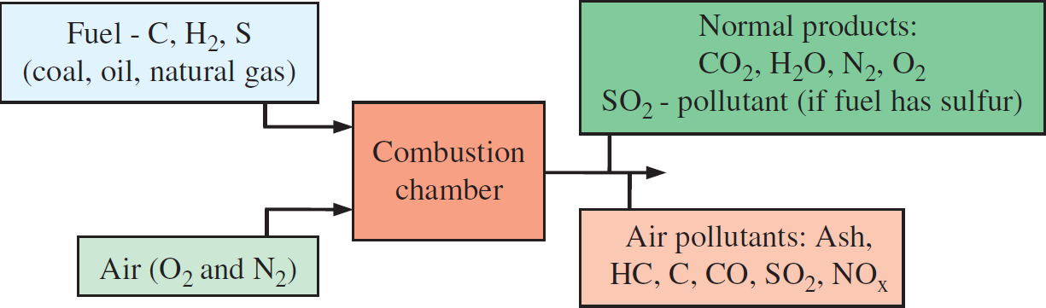
Pollutants
Main air pollutants resulting from the combustion of fossil fuels are
Particulate matter (PM)
Sulfur dioxide (SO₂)
Nitrogen oxides (NO_{x})
Hydrocarbons (HC) including carbon soot particles (C)
Carbon monoxide (CO)

Slide 15
Source of pollutants
Particulate matter is commonly called ash and it is produced mostly when coal or oil is burned.
SO₂ is inevitably produced when the fuel contains sulfur.
NO_{x} generation is due to high temperature reactions between atomic nitrogen and oxygen.
HC, C, and CO emissions are mainly produced due to incomplete combustion which may be due to insufficient oxygen, insufficient mixing of fuel and air, etc.
Methods of minimizing harmful emissions:
The first one is to design and optimize the combustion process such that minimum emissions are generated.
The second method involves after treatment. In this method, the exhaust gases leaving the combustion chamber goes through some systems in which harmful components are treated or collected.

Slide 16
Particulate Matter
Small solid and liquid particles suspended in air is generally referred to as particulate matter (PM).
Primary Content: A primary group of PM is ash and soot particles generated from the combustion of coal and oil.
Secondary PM: Nitrates and sulfates are formed as a result of SO₂ and NO_{x} emissions, and referred to as secondary PM.
Many manufacturing and other industrial processes are responsible for the production of various PMs.
Dust particles from roads and construction and agricultural activities as well as iron, silicon, soil, and materials of earth can also be considered as part of PM.
PM10: When the particles are less than 10 micrometers and classified as coarse.
PM2.5: It refers to particles less than 2.5 mm, and referred to as fine.
“About 1 g of PM is released to the environment for each kWh of electricity produced from a coal-fired power plant”

Slide 17
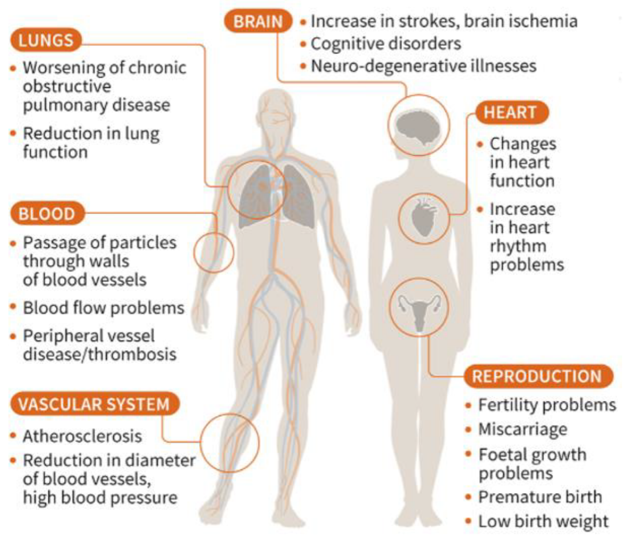
Health impacts of PM2.5
PM2.5 can penetrate deeply into the respiratory system, and therefore it is more dangerous to health than PM10

Slide 18
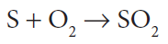
Sulfur Dioxide
Fossil fuels are mixtures of various chemicals, including some amounts of sulfur.
The sulfur in the fuel reacts with oxygen to form sulfur dioxide (SO₂)
Sulfur in coal: Coal contains the most amount of sulfur among fossil fuels.
Bituminous coal contains 0.5 to 4.0% sulfur by mass.
Subbituminous coal typically contains an average of 0.4% by mass.
Low-sulfur coal is more desirable and has high monetary value.
Sulfur in oil: Mass percentage of sulfur in oil may range between 0.3 and 2.3%.
Sulfur in natural gas: Natural gas also contains sulfur with varying amounts when extracted from the ground but it is removed in gas treatment plants

Slide 19
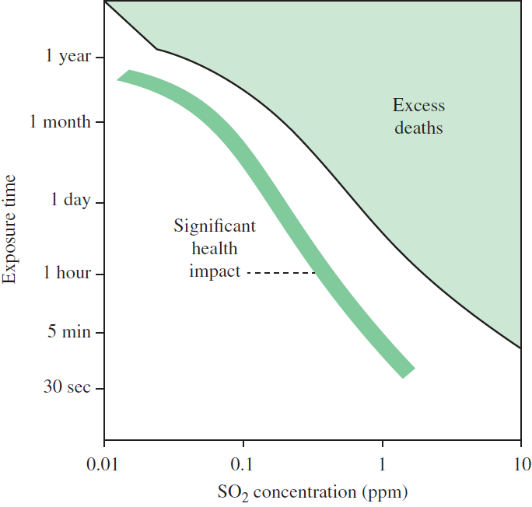
Health effects of SO₂
Longer exposures at low concentrations and shorter exposures at high concentrations may result in the similar health effects.
When SO₂ level in atmosphere is more than 1 ppm, it can lead to airway constriction.
The health effects of SO₂ include respiratory, lung, and cardiovascular illnesses.
Children and elderly with asthma and breathing problems are more sensitive to SO₂ exposure.
It also negatively affects ecosystems of rivers, lakes, and forests.

Slide 20
Nitrogen Oxides
Nitrogen oxides are produced at high combustion temperatures when a fuel is burned with oxygen in air
Effect of combustion temperature: At higher combustion temperatures, more dissociation reactions cause greater amounts of NO_{x} production.
Very little NO_{x} is formed at low temperatures.
Nitrogen oxides react in the atmosphere to form ground-level ozone.
It contributes to the photochemical smog and acidification of waters and soils.
The emission of NO_{x} causes the formation of nitrates, which are considered as PM (mostly PM2.5).
Nitrogen dioxide (NO₂) gas is toxic at high concentrations.
Health effects: The primary health effects of NO₂ are related to respiratory illnesses such as asthma and bronchitis.

Slide 21
Hydrocarbons
In a combustion reaction, some of the fuel cannot find oxygen to react with during the combustion period. As a result, some unburned or partially burned fuel particles leave the exhaust gases as HC components.
Deficiency of air: This will certainly happen when there is deficiency of air (not enough air to burn all the fuel) during combustion.
Causes of HC emissions: Insufficient mixing between fuel and air, nonhomogeneous mixture, and short time of reaction are some of the causes for incomplete combustion and resulting HC emission.
Consequences of HC emissions: Hydrocarbon components and carbon soot particles in air act as irritants and odorants. Some of them are believed to be carcinogenic.
Nitrogen oxides and HC are two main sources for the formation of ground level ozone and also for smog

Slide 22
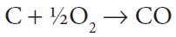
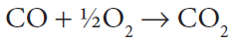
Carbon Monoxide
Carbon monoxide (CO) is a colorless, odorless, poisonous gas.
How is it produced? CO is produced during combustion when there is fuel-rich mixture (not enough air or oxygen in the air-fuel mixture).
If CO cannot find oxygen after the first reaction due to deficiency of oxygen or insufficient mixing, some CO will be part of the exhaust.

Slide 23
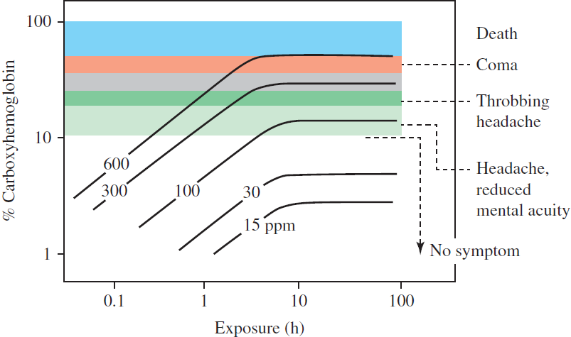
Health effect of CO
Hemoglobin is the protein molecule in red blood cells that carries oxygen from the lungs to the body’s tissues and returns carbon dioxide from the tissues back to the lungs.
Carbon monoxide absorbed in hemoglobin is called carboxyhemoglobin (COHb).
Negative physiological effects on the body are observed when the levels of COHb is above 100 ppm or 0.01%. Serious effects including coma take place after 300 ppm, and long-term exposure above 600 ppm is fatal.

Slide 24
Negative Impacts of Renewables on the Environment
Hydro – The Giant among Renewables Leading to Giant Floods
The dams constructed for harnessing hydropower tend to greatly influence the flow of rivers, which can alter ecosystems and negatively impact wildlife and people.
Wind - It belongs to the Birds and Bats as Well
A recent review by the National Wind Coordinating Committee (NWCC) found that collisions with wind turbines and air pressure changes caused by spinning turbines resulted in several bird and bat deaths.
Solar – What about the Soil Erosion?
The use of many acres of land can result in clearing and grading of land, which can cause soil compaction, erosion, and alteration of drainage channels. Disposal of solar panels and collectors after their useful life is a concern for solar systems.
Biomass energy involves ecological impacts of harvesting, transportation, and processing of plants.
Geothermal systems are known to contribute to hydrogen sulfide (H₂S) emissions.

Slide 25
Calculate the theoretical amount of air.
Constituents | % By weight
Carbon | 85.9
Hydrogen | 12
Oxygen | 0.7
Nitrogen | 0.5
Sulphur | 0.5
H2O | 0.35
Ash | 0.05
GCV of fuel : 10880 kcal/kg
Considering 100 kg of furnace oil, the chemical reactions are:
C + O₂ → CO₂
H₂ +1/2 O₂ → H₂O
S + O₂ → SO₂
Consider molecular weight in kg/kg mole

Slide 26
Recap
Fuel types
Basics of Combustion
3 Ts to optimize combustion
Air-Fuel ratio and Excess air
Air pollutants, types, source, heath effects and elimination techniques

Slide 27
References
https://www.mdpi.com/2071-1050/13/7/3726
https://byjus.com/physics/electrostatic-precipitator/
https://www.weforum.org/agenda/2022/12/ozone-layer-hole-update-nasa/
https://ourworldindata.org/outdoor-air-pollution#concentrations-of-air-pollution
https://savree.com/en/encyclopedia/flue-gas-desulphuriser
https://www.sciencedirect.com/science/article/pii/B9780128239551000012
https://www.altenergymag.com/article/2015/08/the-dark-side-of-renewable-energy-negative-impacts-of-renewables-on-the-environment/20963/

Slide 28
References
https://www.sitams.org/assets/pages/hands/material/R18/Engineering%20Chemistry/Fuels%20and%20combustion.pdf
https://iea.blob.core.windows.net/assets/830fe099-5530-48f2-a7c1-11f35d510983/WorldEnergyOutlook2022.pdf
https://research.tamu.edu/2015/05/01/study-switch-to-alternative-fuels-could-cost-state-millions-in-revenue/
https://assets.weforum.org/wp-content/uploads/2015/11/Alternative_Fuels_Data_Center_Alternative_Fuels_and_Advanced_Vehicles_-_2015-11-30_10.00.59.png

